Slide 1
Rahman Ismail Sr. Software Architect
USB 2.0 Overview

Slide 2
USB Training Agenda
Day 1
Overview of USB 2.0 and USB 3.0
Introduction to OTG 2.0 and 3.0
What’s in the future for USB
Day 2
HSIC and SSIC
USBIF and WHCK Certification
Any other topics you would like to hear about

Slide 3
Agenda
USB Fundamentals
What changed with USB 2.0?
USB 2.0 Performance
USB 2.0 Enhancements
Summary

Slide 4
USB 2.0 BUS Overview
USB 2.0 subsumed the USB 1.1 Specification
All devices are USB 2.0 devices
You cannot build a USB 1.1 device anymore
USB 2.0 is a half duplex bus
All transactions are initiated by the host
Supports 3 speeds
Low Speed (LS): 1.5 Mb/s
Full Speed (FS): 12 Mb/s
High Speed (HS): 480 Mb/s
Maintains backwards compatibility with USB 1.1

Slide 5
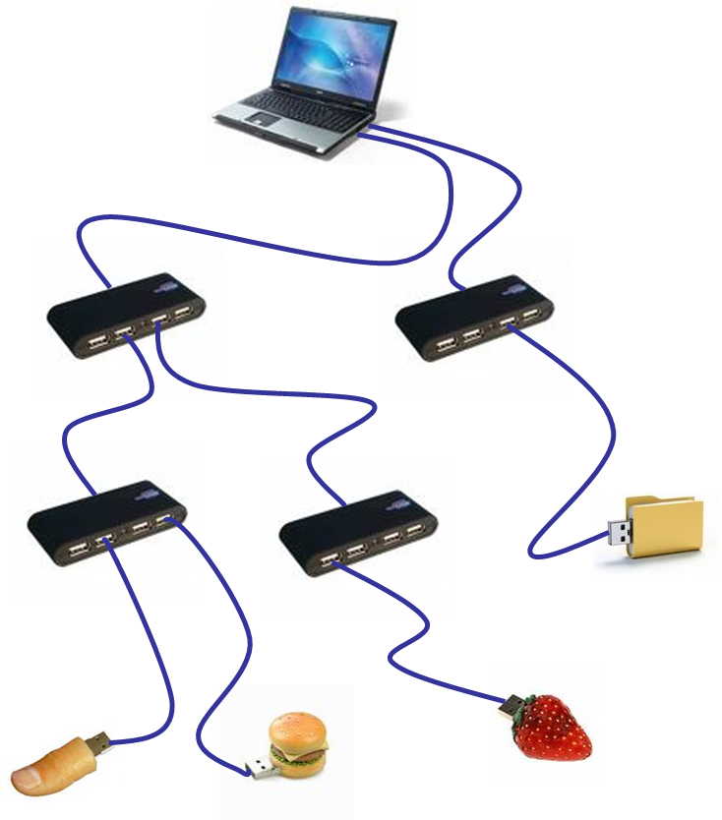
USB 2.0 BUS Overview
USB topology is a tiered star topology
Only one host in the system
Supports up to 5 cascaded hubs
USB cable has 4 wires
Signaling over D+/D-
V_{BUS}
GND

Slide 6
USB 2.0 Transactions
USB 2.0 is a broadcast half duplex bus
Polled Transactions
Transactions consist of 3 parts
Token
Data
Handshake
Average turn around time between the 3 phases
< 350ns

Slide 7
USB 2.0 Transactions
All transactions are to an endpoint
Endpoints are the terminus for every transaction
4 types of Endpoints
Control – used to configure devices at attach time
Bulk – used to move large amounts of data (not time constrained)
Interrupt – used to convey human perceptible data or change in status
Isochronous – used to move a fixed amount of bandwidth within a pre-negotiated time constraint
A device always supports a default control endpoint
Used to determine the type of device and to enumerate the device

Slide 8
USB 2.0 Framework
USB Framework
Use descriptors to describe a device
Device Descriptor
Configuration Descriptor
Interface and Endpoint Descriptors
Software interfaces
USBDI
Device Descriptor
Config Descriptor
Interface Desriptor
Length includes all descriptors in set
Endpoint Descriptor
Endpoint Descriptor
Interface Descriptor

Slide 9
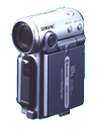
USB 2.0 Enumeration
Client Drivers
Client Drivers
USB Driver Interface
Composite Class Driver
Client Drivers
Client Drivers
USB Driver Interface
4
Hub Driver
3
Internal Hub/Host Interface
Host Controller Driver
2
Host Interface
Host Controller
1

Slide 10
USB 2.0 Enumeration

Slide 11
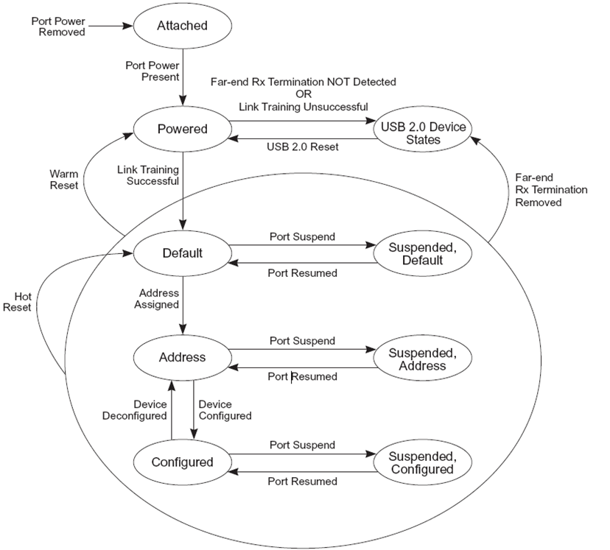
USB Device States

Slide 12
USB 2.0 Power
Power distribution and consumption
2.5ma suspend
100ma unconfigured
500ma configured
Support for Suspend/Resume
Topology management
Hub features to handle connect, disconnect, enable, disable, …

Slide 13
Agenda
USB Fundamentals
What changed with USB 2.0?
USB 2.0 Performance
USB 2.0 Enhancements
Summary

Slide 14
USB 2.0: What Changed?
Low level electricals for High Speed (HS) signaling
Higher bit rate (480Mb/s) requires new transmitter/receiver
Hub changes for backward compatibility
Features limit bandwidth impact of Full Speed (FS) and Low Speed (LS) devices on HS devices
FS/LS devices consume a bit-rate equivalent of HS bandwidth

Slide 15
USB Hubs
Client Driver
Client Driver
System SW
USB 2.0 Host
Controller
High Speed Only
HS Hub
USB 1.1 Hub
USB 1.1 Device
USB 1.1 Hub
HS Device
(2 x 12Mb/s
Capacity)
USB 1.1 Device
Full/Low Speed
Hub provides high-speed expansion (ala USB 1.1 hub)
Hub provides additional Full/Low speed bus(es)

Slide 16
USB 2.0 Hub
High Speed only
Hub
Controller
Transaction
Translator
HS Signal
Repeater
Routing Logic
Full/Low
Speed
Port
Port
Port
Port
Hub controller same as USB1.1
Routing logic connects device to appropriate path

Slide 17
USB 2.0 Host Controller
USB 2.0 Host Controller (HC)
USB 1.1
HCs
High-Speed Mode
(Enhanced Interface) USB HC
HC Control Logic/Data Buffering
Enhanced HC Control Logic
Enhanced Data Buffering
Port 1
Port 2
Port N
Port 1
Port 2
Port N
Port Owner
Control(s)
Port Routing Logic
Port 1
Port 2
Port N
Retains backwards compatibility
Includes one or more 1.1 Host Controllers
Overtime replaced with integrated USB 2.0 Hub

Slide 18
Transaction Translator (TT)
TT handles low/full speed transactions
Driven with split transactions
Start-Split
Host tells Hub to initiate full/low speed transaction
Complete-Split
Host asks Hub for results of previous full/low speed transaction

Slide 19
ISOCH IN through a TT
HS Bus
uSOF
uSOF
uSOF
uSOF
uSOF
uSOF
uSOF
uSOF
uSOF
SS
CS
CS
CS
CS
125us
SS = Start Split
CS = Complete Split
SOF
SOF
Full Speed Bus
1ms

Slide 20
Agenda
USB Fundamentals
What changed with USB 2.0?
USB 2.0 Performance
USB 2.0 Enhancements
Summary

Slide 21
Bulk Throughput
Bytes per Second
Buffer
size
Number of Endpoints

Slide 22
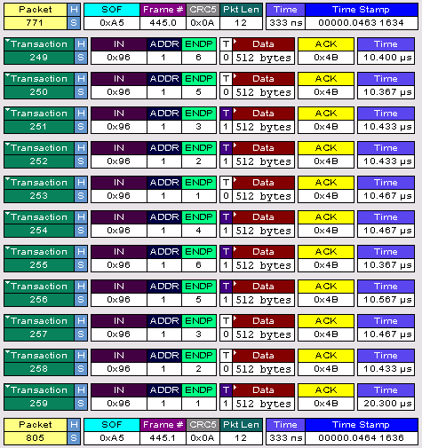
Bus Traffic
11 packets/uframe
44 MB/sec
75% bus utilization
Theoretical max is 13 packets/uframe
* Other names and brands may be claimed as the property of others.

Slide 23
Agenda
USB Fundamentals
What changed with USB 2.0?
USB 2.0 Performance
USB 2.0 Enhancements
Summary

Slide 24
USB Traffic in a Mobile System Idle/associated USB-based Packet (Network) Device
BUILD
Processor
“USB Penalty” Approaches Zero (normal bus)
Caching suppresses traffic upstream of ICH
Processor/FSB/DMI in low power states
GMCH and memory are in low power states
ICH USB Host Controllers and High-Speed USB interface fully active
Deferring suppresses traffic throughout entire system
Processor/FSB/DMI in low power states
GMCH/memory are in low power states
ICH USB Host Controllers quiescent and awaiting host or device event
USB interface in FS-IDLE
Processor/FSB active servicing snoops from USB descriptor accesses (C2 vs. DC4)
DMI interface active (L0 vs L1)
GMCH local PM hampered (clock gating, DLL/buffer PM)
Memory out of self-refresh
ICH USB HCs and HS-USB interfaces active
FSB
Snoop processor
GMCH
DDR
MEMORY
DDR
MEMORY
DMI
Access USB schedules
Δ=5.7W
17.3
16.5
15.3
USB
ICH
Poll device
13.3
Δ=1W
Δ=0.2W
CLK
USB
“packet”
11.9
11.1
ICH
HS-USB
Watts*
10.9
Mem
11.3
GMCH
9.3
CPU
Nak, Nyet
7.3
Deferring w/ Device LPM L1
Caching Only
Baseline – No Fixes
No USB
USB
Cache
Defer

Slide 25
USB Traffic Patterns
Low/Full Speed Traffic
Isoch
Interrupt
Bulk/Control
Frame Pointer
iTD
iTD
QH
QH
QH
QH
TD
TD
TD
TD
~16µs
1ms
TD
TD
TD
TD
TD
TD
High-Speed Asynchronous Traffic
High-Speed Periodic Traffic
QH2
0
1
2
3
4
5
6
7
8
9
10
11
12
13
14
15
QH1
QH3
~8µs
Sleep
125µs

Slide 26
Link Power Management (LPM L1)
New low-latency L1 low power state intended for dynamic use with active or idle devices
Benefits
Transitional latencies are much faster than suspend/resume
Explicitly entered with an LPM Transaction which the device can reject
L1 exit can be initiated by host or device
Building-block for the energy efficiency latency infrastructure

Slide 27
Summary
USB 2.0 specification encompasses all devices (LS, FS, HS)
Half Duplex Bus
Only one host in a system
Supports four transfer types
Hubs are an integral part of USB and provide port expansion

